Slide 1
An Introduction to Android Development
Basics, Technical Constructs and Practices.

Slide 2
Before We Start, make sure….
Android SDK Installed.
IntelliJ setup and configured.
Emulator Created.
The demo app is checked out and running from - git@github.com:androidbootcamp/DroidBootcamp.git

Slide 3
Agenda
What is an Activity
How does a basic project look like.
Write an app to calculate the sum of two numbers.
Navigation between Activities using Intents.

Slide 4
Basics
Project Structure
Android Manifest
Resource Files
Source Code
Application Components
Activities
Services
Broadcast Receivers
Content Providers
Intents
Action
Data
Intent Filters
Tests
Junit or Android Junit ?
Instrumentation API and ActivityInstrumentationTestCase2 or Robolectric

Slide 5
Get Started
Default Activity in Manifest
Content Layout
UI Events - On Click Listeners

Slide 6
A + B = C
Add a second operand.
Change the result to sum of two inputs.

Slide 7
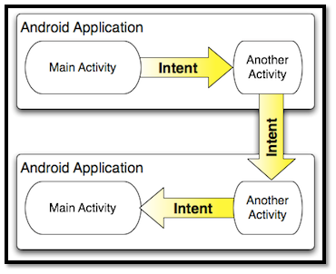
Navigation using Intents

Slide 8
Navigation using Intents
Types of Intents – Explicit and Implicit
Action, Data
Navigation using Explicit Intents
Define Intent and Start Activity

Slide 9
Components
Activities, Services, etc.
Application Object

Slide 10
For tomorrow’s session, make sure….
You have cloned kranti from git@github.com:rohinik/Kranti-Android.git
Kranti app is running properly in your device.

Slide 11
References
http://www.vogella.com/articles/Android/article.html
http://developer.android.com/guide/components/intents-filters.html
http://developer.android.com/guide/components/fundamentals.html
http://developer.android.com/training/index.html

